Slide 1
Oracle Database Change Management
Implementing CI/CD with SQLcl Projects
Jeff Smith
Distinguished Product Manager

Slide 2
Background and motivation
Helping development teams simply their development and release processes.
Notes:
Did you know we have a dedicated team here at Oracle to build tools and solutions for Oracle Database developers? In the past few years, we’ve been working to make the often, hand-on, bespoke, and error prone process of building and managing application schema installs and upgrades in your databases, easier, regimented, and automated.

Slide 3
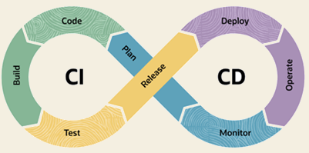
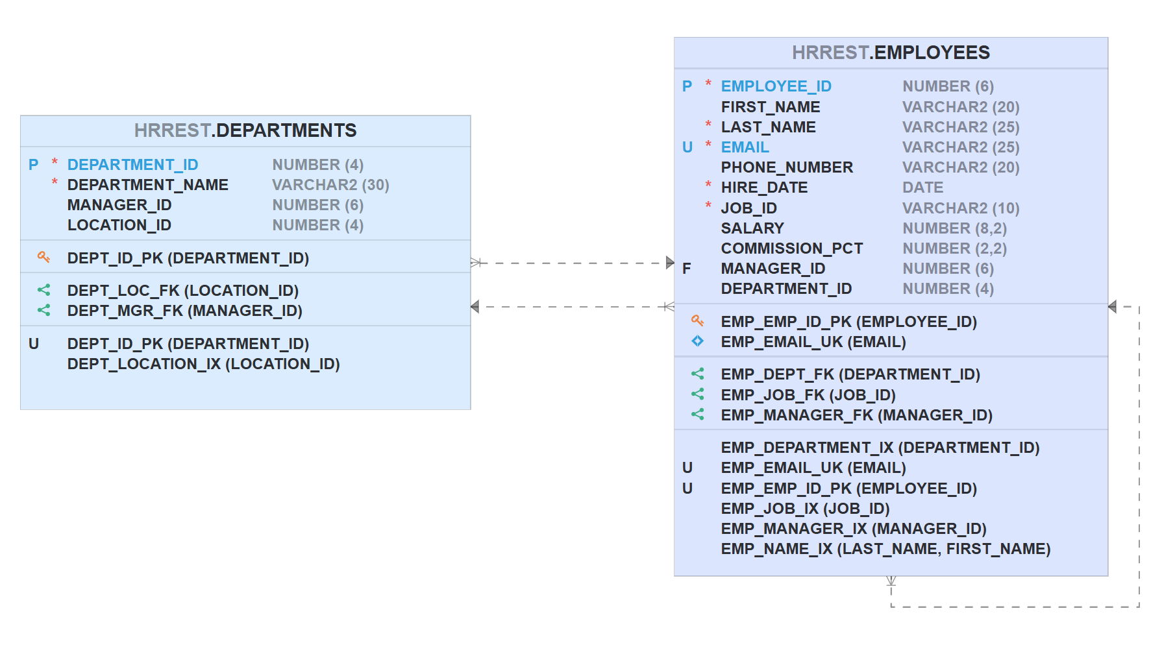
Always be shipping.
Your business needs to deliver value to your customers at a rapid pace.
Your development teams need a process where they can…
consistently
easily
quickly
…deploy their changes to dev, test, and PROD environments.
Code is fairly straightforward. But what about your database objects and their data?
Notes:
The pace of business, innovation, and meeting customer expectations is not going to slow down anytime soon. The ability for development teams to adopt practices such as Continuous Integration and Deployments allows for teams to ‘go fast’ and ‘deliver frequently’ but also increase the confidence that no one is going to ‘break the build’ and decrease the number of bugs and install/upgrade failures.
This has been a hard problem for database developers for many years, primarily because our data is a ‘living animal,’ compared to our application code. Care must be taken to make sure columns aren’t dropped vs renamed and recreated with the new name bercause for some reason, people don’t like it when their data ‘goes away,’ but the logs say everything ran ‘without errors.’
Our customers were left to sort this problem for themselves by building a custom solution, or reach out to 3rd parties for help or off-the-shelf software.
Oracle and the Database team have built a native, free solution now that addresses this problem, and we’d like to take the next 15-20 minutes to show you what we have.

Slide 4

Why is CI/CD for database, hard?
Lack of standards.
How are db changes added to Git?
How are upgrades from dev to test implemented?
How are installs synchronized?
No consistent tooling.
Schema changes
Deployment tools
data
High risk deployments.
Notes:
Databases in general are not setup to easily plug-in to CI/CD. Why not?

Slide 5
Oracle SQLcl Projects
What is it, how does it work, how does it help us?
Notes:
Oracle SQLcl is our modern command line interface, and it now offers a ‘project’ command for developers to seamlessly work on their applications and databases with Git, and have that work described in source code directories, and also generate distributables, which are deployed to databases with a structured, ordered, controlled installer (via Liquibase).

Slide 6
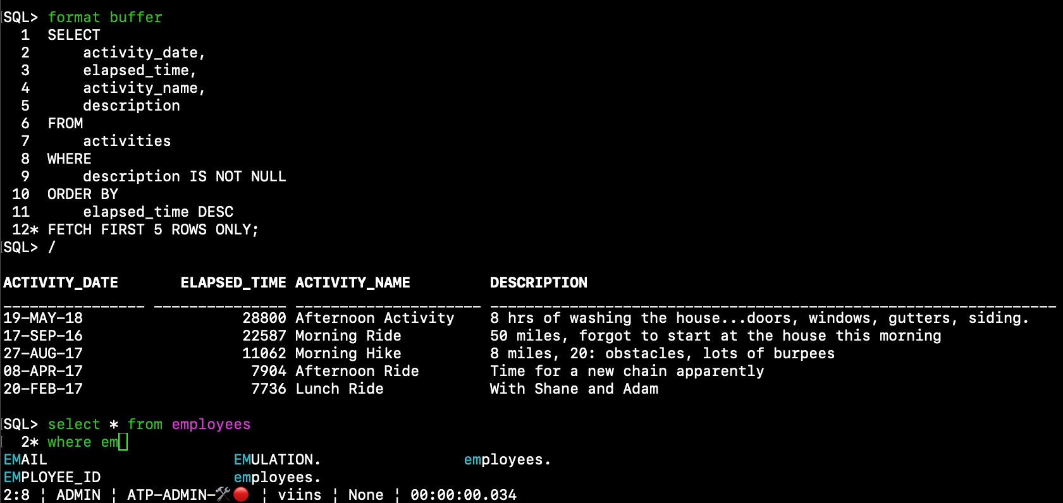
Your modern Command Line Interface for the Oracle Database
Seamless connectivity
Free
Easy to install
Unzip, YUM, Docker, OCI, Homebrew, Chocolatey
IDE features
Formatting, Auto-Completion, Aliases, powerful editor (vi/emacs), Automatic output formatting
Handy Utilities
Data Pump, Load, AWR, Data Guard, OCI, MLE, CodeScan
Oracle SQLcl
Notes:
If you’ve not worked with SQLcl before, it’s our modern CLI for the database, combining the best of SQL*Plus and SQL Developer.
You can define connections to your database, on prem on in the cloud, and have your credentials automatically secured via Wallets.
It ships with the database, but can also be easily installed or updated.
It has powerful features found in most IDEs, but available in your terminal!
And it makes general day-to-day tasks like loading data or finding performance and security issues in your code, EASY.
If time permits, NOW is a good time for quick demo: use tab completion for a basic SQL query Select * From employees where comm <hit tab button> Run query <ctrl+R> Use Up Arrow to use sql history, now change the SELECT clause, add a /*insert*/ comment, run again, show output as INSERT statements. Use the HELP command to show list of all commands – underlined commands are what are net new added above SQL*Plus. Use INFO EMPLOYEES to contrast with DESC EMPLOYEES

Slide 7
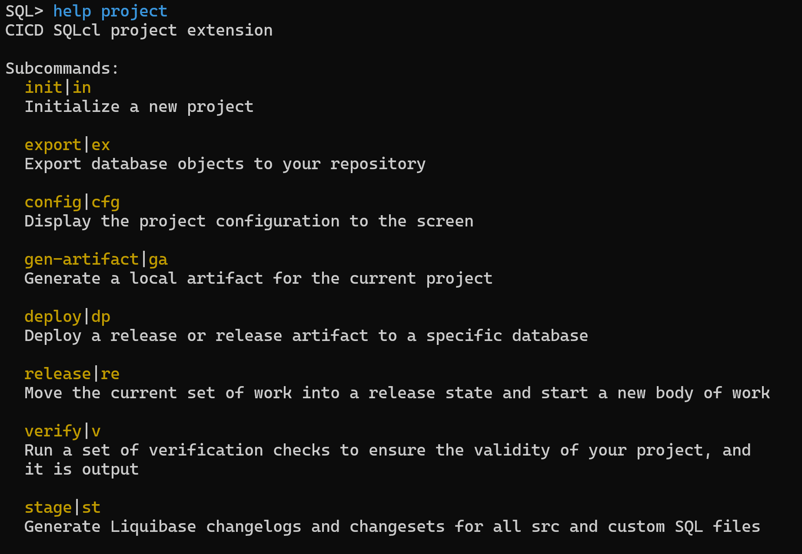
Your new favorite SQLcl command: project
Defines:
a prescribed process for database developers
a recommended file structure
tools to automate developer daily tasks
Generates releasable artifacts, based on atomic developer changes.
Flexible, work with your existing or new projects.
Notes:
We’re ready for the star of our show. PROJECT is a command, and it allows us to setup a Git repo with our database application
It will help us generate the base of files, by exporting the current contents of your database.
We’ll take you through each of the basic steps now.

Slide 8
Workflow
Project Creation init
Git required
Great for new and existing database applications
SQL> project init -name HrManager –schemas DEV_USER
SQL> !git init --initial-branch=main SQL> !git add . SQL> !git commit –m “chore:init HrManager git rep”
Notes:
The name of your project is arbritary, and you can choose to have it based on 1 or more schemas in your database.
Most of these commands come with many additional options, such as FILTERS to exclude or only include specific objects or types of objects.
The settings or configurations for our project will be found in a DOT .dbtools folder

Slide 9
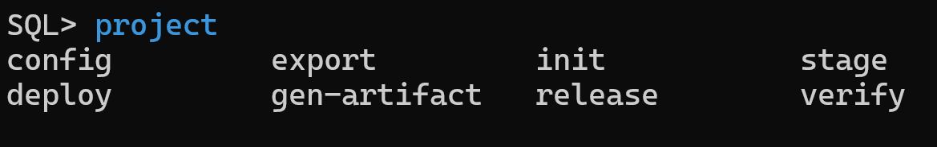
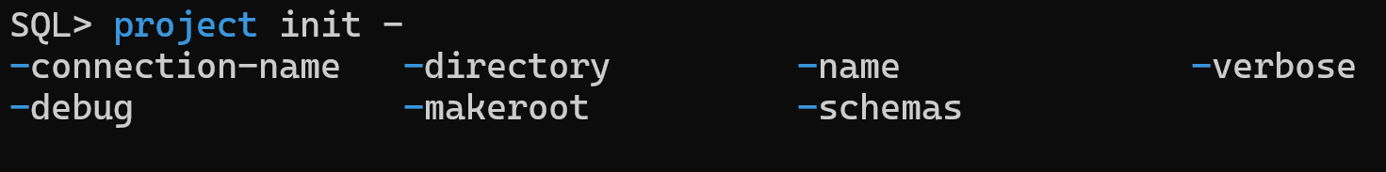
SQLcl Tip: use the <tab> key
Notes:
As you’re typing the project command and subcommands and options, you can always hit TAB to get help!

Slide 10
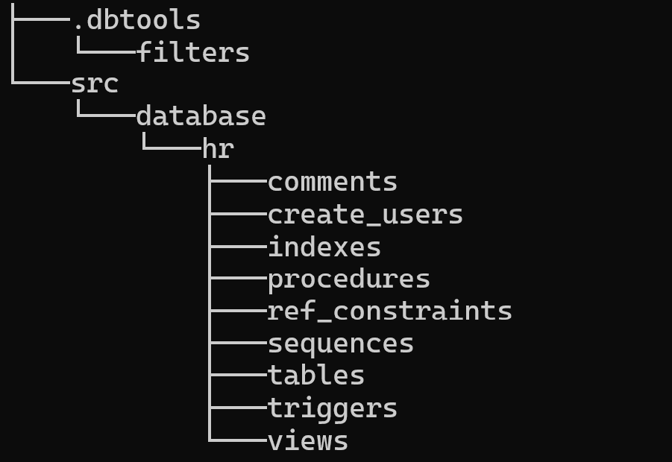
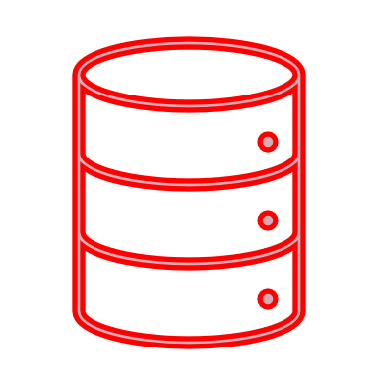
Workflow
Project export
Generate src files from database
Defaults to everything in your schema(s), filters avail
State of database objects
SQL> project export
The current connection HR will be used for all operations *** INDEXES *** *** PROCEDURES ***
*** SEQUENCES *** *** TABLES *** …
SQL> !git add --all SQL> !git commit –m “Export dev_user schema”
Helps track evolution of objects over time
Useful for compiling code
Views, packages, triggers, etc.
Notes:
The export command will grab all of the intended objects from our one or many schemas, by default grabbing everything, but you can use filters to include or exclude objects.
You’ll see the project directory structure under the ‘src’ or SOURCE folder, broken out by object types. All of the objects will be represented as .SQL files, based on the current state on the database you’re connected to.
As you’re creating/adding/changing files, you’ll be running your Git commands as needed, commiting, merging, branching, etc.

Slide 11
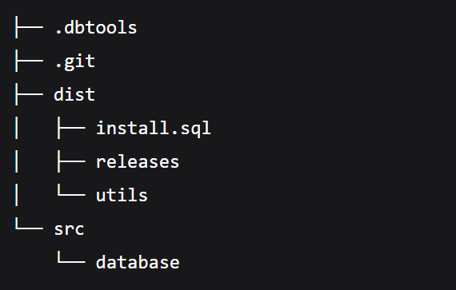
Workflow
Project stage
Generates scripts to apply changes to database objects
DIFF of main & current branch of src
Writes to dist/releases/next
Ordered SQL for state in src
SQL> project stage
Starting execution of stage command using the current branch Created dir:
dist/releases/next/changes, dist/releases/next/code
Complete control over schema evolution
Used to create an installer, maintained and controlled by Liquibase
Notes:
Stage is based on source, but we get the first look at how our objects will be pushed to target environments.
Instead of looking at the database, we look at the diff between main and your current branch. Your current branch for the first go around will always be empty, so the DIFF output will generally be copies of what’s in source.

Slide 12
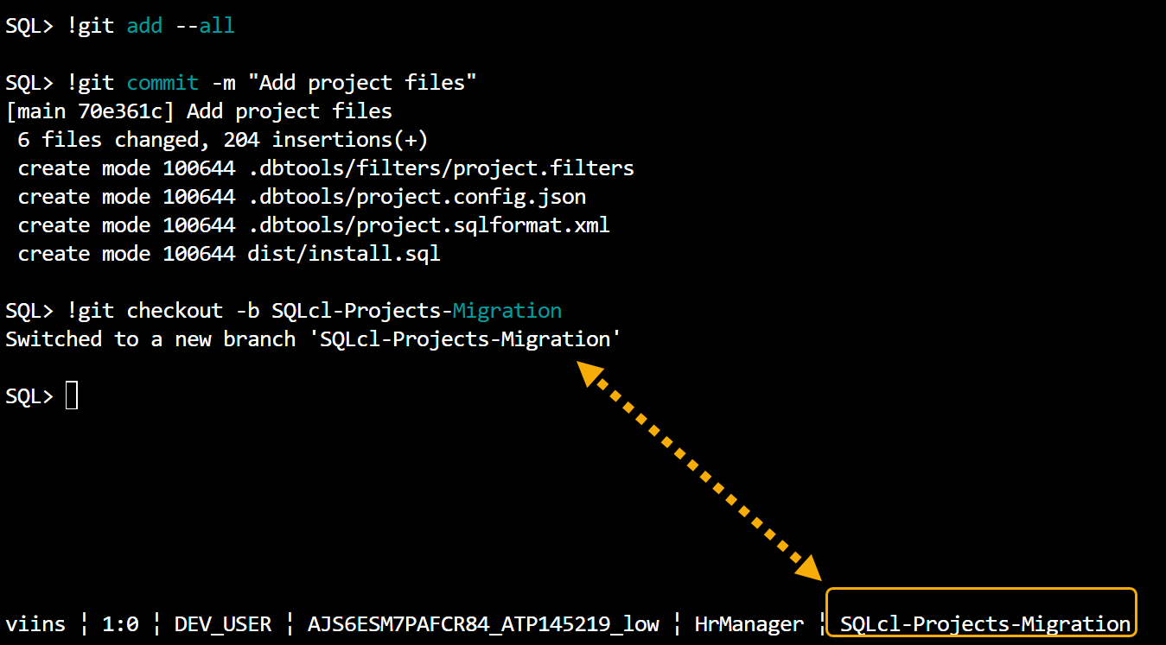
SQLcl Tip: Setup StatusBar to remind you $project & $branch
set statusbar on set statusbar add git | project
Notes:
It’s VERY important that you’re working on the project and Git branch that you think you are!
SQLcl’s statusbar is handy to help you remember, what’s what.
Including the user you are connected as, the connection you’re using, how long your last query took to run, etc. The statusbar is OFF by default, so you’ll need to enable it.
I suggest you add this to your login.sql script, so it starts up the way you like it!

Slide 13

Source vs Distributables
src
dist
create table emp (
empno number,
fname varchar2(50),
lname varchar2(50)
);
create table emp (
empno number,
fname varchar2(50),
lname varchar2(50)
);
create table emp (
empno number,
fname varchar2(50),
lname varchar2(50),
deptno number
);
create table emp (
empno number,
fname varchar2(50),
lname varchar2(50)
);
alter table emp
add deptno number;
create table emp (
empno number,
fname varchar2(50),
lname varchar2(50),
deptno number,
name varchar2(100)
);
create table emp (
empno number,
fname varchar2(50),
lname varchar2(50)
);
alter table emp
add deptno number;
alter table emp
add name varchar2(100);
alter table emp
drop column fname;
alter table emp
drop column lname;
v1
v2
v3
Notes:
Let’s take a good look at just how source and dist are laid out.
V1 we have a 1;1 relationship more or less.
As we go to our ‘next’ release, say 2.0, then our DIST will start to add changes to the existing table with DDL ALTERs for example.
So we added a column, what happens if we do something more…fun? In v3 we add a another column and DROP two additional columns.
This is a scenario where you might want to customize the dist file, to run a UPDATE command to populate NAME based on fname || lname before running the DROPs!

Slide 14
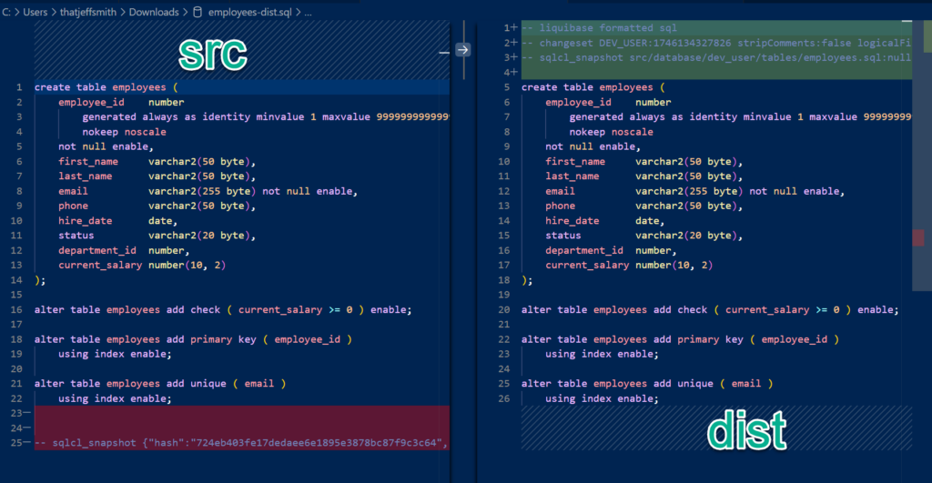
SQL type changelog, allows for Liquibase release management
Notes:
When these files are submitted to the database, they are presented as Liquibase changeSets.
Liquibase controlled schemas have a LIQUIBASE set of tables, that are used to track what changeSets have been applied, what dependencies they require, who executed them and when, and etc.
SQLcl generates the SQL files, and also includes the Liquibase metadata, see the top of our DIST file fro the employees.sql changeSet.

Slide 15
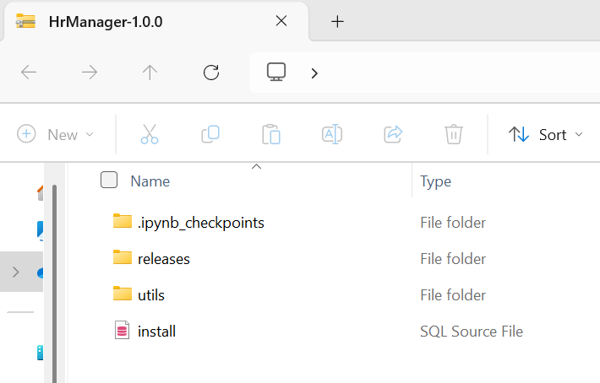
Workflow
Project release & gen-artifact
Generates a set of objects for release/version x.y.z
dist/releases/next -> x.y.z
A new ‘next’ release is created
Bundles up install for deployments
SQL> project release –version 1.0
SQL> project gen-artifact
Notes:
To prepare a release, we need to go from ‘next’ to our actual release number, and we do tha twith the release command.
The existing NEXT folder is renamed to that release label, and then we create a new ‘Next’
When we run the ‘gen-artifact’ command, that release is packaged up, including the install.sql file – which has the ilst of changeSets that will be run, properly sorted in the correct order.
Note this might need changed/tweaked! In our CI/CD process, we might be running this workflow multiple times a day! We will find all these problems in our dev cycle and in our testing. Once we get to the actual PROD release, we can do so with confidence because we’ve already done this 200x for example.

Slide 16
But, what if…?
We develop an app across multiple schemas.
We need to add custom code.
We run multiple apps out of a single schema.
We also use APEX.
We also have ORDS REST APIs.
We’re already using your SQLcl Liquibase command.
We have a team of developers, all working on the ‘same things.’
We run into problems, and need to fix the install/upgrade?
Notes:
Ok, I’m guessing we have some questions in the room, let’s cover the biggest FAQs.
A project can be defined against one or more schemas – on the init, just supply a comma separated list.
If you want to add custom scripts to be included in your installer-artifact, we have a
PROJECT STAGE ADD-CUSTOM command, you supply the file name. We create the stub of the file for you, you add your stuff, then you make sure it’s ordering placement in the install.sql is as you desire.
If you’re running 5 apps in a single schema, that’s…maybe less than ideal, but there are reasons to do this. When you do your export, use the filters to specific what to include or exclude, remember by default we’ll grab everything!
We support both APEX apps and ORDS REST APIs in your projects! We’ve even hosted a webinar showing the APEX workflow and the replay is availi on the Oracle Developer YouTube channel, just search on ‘apex’ and ‘projects’.
If you’re using the SQLcl Liquibase command to generate your own schema and/or object changeLogs and ChangeSets, this represents a BIG change compared to projects. Instead of dynamically figuring out how to upgrade an object based on it’s current state in the target database at runtime, the project command is based on Git and comparing branches and maintaining well defined releases. If you’re happy with your current SQLcl Liquibase process, keep it! If you find the Project command and workflow alluring, we think it’s worth a look and considering moving to!
Multiple people working on the same projects or even database objects will lead to conflicts when you work your merge requests. Those issues are more about process and team communication setups vs the technical aspects of SQLcl and Projects and Liquibase changeSets.
If you DO run into a problem, unless it’s your DEV environment, you will ‘fix it forward’ – that means cutting a new JIRA ticket for a developer or devops engineer to code a fix, and deliver it as another SQLcl project release artifact, that again gets controlled and recorded by Liquibase. You COULD set up something with database flashback or doing a rmain point in time recovery, but again these instances should be the EXCEPTION in a good CI/CD pipeline, because again, we’ve done and walked this install or upgrade HUNDRDES OF TIMES in our dev and test and qa environments.
Remember, this PROJECT feature was designed to be flexible! What we’ve shown is a very brief look at how it works, out-of-the-box. If you have specific what-if questions, join our community and interact with fellow customers and our SQLcl engineers!

Slide 17
Key takeaways & next steps
What did we learn today, and how do we learn more?

Slide 18
Summary
Oracle Database now has an official database schema application install/upgrade/change management solution.
It’s FREE.
It’s built on top of Git.
Oracle SQLcl generates and maintains your SRC an DIST branches for your project.
We build an installer, that runs the SQL scripts, controlled via Liquibase.
CI/CD for the Oracle Database is officially supported by Oracle!
Notes:
Just read the slide.
Summary, summary – this is a very opinionated, specific workflow for implementing database schema change management, and integrating it with Git, and then producing artifacts for installs and upgrades. If you’re starting from scratch, or think there must be a better way than what your’e currently working with, this is our solution.
We’re using this internally here at Oracle for several very important customer facing solutions including our Oracle Forums platform, and even the content management system used to control the content on Oracle Dot Com!

Slide 19

Next Steps
Download SQLcl https://www.oracle.com/sqlcl
Learn via our LiveLab! Complete walk-through, init a project, synch with production, make changes, do an upgrade.
Ask a Question https://forums.oracle.com/ords/apexds/domain/dev-community/category/sqlcl
Watch the Movie! 60 minute webcast with Jeff as he talks about SQLcl projects and Liquibase.
Notes:
Use the QR code to navigate to our SQLcl projects hands-on lab! If you’re going to Oracle Cloud World, attend our live live-lab session, we’d love to see you there!
Search youttube for ‘Build CI/CD pipelines with Autonomous Database and Oracle SQLcl Project”

Slide 20
Thank you! Questions?
jeff.d.smith@oracle.com
Notes:
Our product manager, Jeff Smith (yes, that jeff smith) loves talking to our customers. Feel free to drop him a line if you have questions or want to provide feedback.
But while we have your attention, let’s cover questions now as time allows!

